Slide 1


DATA STRUCTURE USING C
BANK MANAGEMENT SYSTEM USING LINKED LIST
Guided by:
Prof. V. M. Bande.
Submitted by:
Kaushal Khachane (33)
Abhishek Patil (49)

Slide 2
Contents
Literature review
Abstract
Introduction
Algorithum and Flowcharts
Project Outputs
Course outcomes achieved
Conclusion
References

Slide 3
Literature Review
Bank Management System using c this project is developed using linked list. Linked list is linear data structure.
Dynamic memory allocation make linked list operation efficient. We can store customer data upto memory becomes available. Linked list stored collection of data.
Various operation performed on linked list are insertion, deletion, traversing. We can use such operation in our project. By using such function we implement bank management system project.

Slide 4
Abstract
The Bank Account Management System is an application for maintaining a person's account in a bank.
In this project I tried to show the working of a banking account system and cover the basic functionality of a Bank Management System.
In this Project user can Create Account, Modify Account, Manage Transaction, Delete Account, Search Existing Account and Display All the Account In Bank.
The main aim of this project is to develop software for Bank Account Management System. This project has been developed to carry out the processes easily and quickly.

Slide 5
Introduction
We developed Microproject in C bank management system using linked list during our third semester. This project is focused on customer account services in bank.
Here, we can create a new account, update information of an existing account, view and manage transactions, check the details of an existing account, remove existing account and view customers’ list.
Overall, with this project, you can perform banking activities like in a Real bank.
The project code for this project is around 490 lines. The project code is password protected (password is dsuproject).

Slide 6

In this project we use singly linked list. A linked list a data structure which contain two field.
1. Data
2. Pointer to next node
Head pointer contain the address of the first node and the last node contain NULL to indicate end of the list.
Node Creation:-
Struct node{
int data;
struct node *next;
};
Struct node *Head, *Ptr;
New node = (struct node *)malloc(size of(struct node));

Slide 7
Algorithm To Insert Record Into Bank
Step 1: START
Step 2: IF AVAIL = NULL
Write OVERFLOW
Go to step 15
Step 3: SET NEW_NODE = AVAIL
Step 4: SET AVAIL = AVAIL->NEXT
Step 5: SET NEW_NODE->DATA = VAL
Step 6: IF START = NULL
Step 7: NEW_NODE->NEXT = NULL
Step 8: START = NEWNODE
Go To Step 15
Step 9: ELSE
Step 10: PTR = START
Step 11: WHILE PTR != NULL
Step 12: PTR = PTR->NEXT
[END OF LOOP]
Step 13: PTR->NEXT = NEW_NODE
Step 14: NEW_NODE->NEXT = NULL
[END OF IF]
Step 15: EXIT

Slide 8
Flowchart To Insert Record Into Bank
START
PTR=START
IF AVAIL = NULL
YES
WHILE PTR->NEXT != NULL
OVERFLOW
YES
PTR=PTR->NEXT
NO
AVAIL=AVAIL->NEXT
NO
PTR->NEXT=NEW_NODE
NEW_NODE->DATA=VAL
IF START = NULL
NO
EXIT
YES
NEW_NODE->NEXT=NULL
START=NEW_NODE

Slide 9
Algorithm To Update Details Of Exiting Account
Step 1: START
Step 2: IF START = NULL
Write UNDERFLOW (THERE IS NO BANK ACCOUNT TO MODIFY)
Go To Step 14
Step 4: ELSE
Step 5: PTR = START
Step 6: WHILE PTR != NULL
Step 7: IF AcNum = Record
Step 8: Switch(ch)
Step 9: Case 1: PTR->NAME = NEW_VAL BREAK
Step 10: Case 2: PTR->ADDRESS = NEW_VAL BREAK;
Step 11: Default: TRY AGAIN
Step 12 ELSE
Step 14: PTR = PTR->NEXT
[END OF IF]
[END OF LOOP]
[END OF IF]
Step 14: EXIT

Slide 10
Flowchart To Update Details Of Exiting Account
START
IF START = NULL
YES
UNDERFLOW
PTR = START
NO
WHILE PTR != NULL
YES
IF ACNUM = RECORD
NO
PTR=PTR->NEXT
YES
SWITCH(CH)
CASE 1:
PTR->NAME = NEW_VAL
CASE 2:
PTR->EMAIL = NEW_VAL
EXIT

Slide 11
Algorithm To Manage Transaction
Step 1: START
Step 2: IF START = NULL
Write UNDERFLOW (THERE IS NO BANK ACCOUNT)
Go To Step 12
Step 3: ELSE
Step 4: PTR = START
Step 5: WHILE PTR != NULL
Step 6: IF AcNum = Record
Step 7: Switch(ch)
Step 8: Case 1 = PTR->AMT = PTR->AMT + DEPOSITE
Step 9: Case 2 = PTR->AMT = PTR->AMT – WITHDRAWAL
Default = TRY AGAIN
Step 10: ELSE
Step 11: PTR = PTR->NEXT
[END OF IF]
[END OF LOOP]
[END OF IF]
Step 12: EXIT

Slide 12
Flowchart To Manage Transaction
START
IF START = NULL
YES
UNDERFLOW
NO
PTR=START
WHILE PTR != NULL
YES
IF ACNUM = RECORD
NO
PTR=PTR->NEXT
YES
SWITCH(CH)
CASE 1:
PTR->AMT = PTR->AMT + DEPOSITE
CASE 2:
PTR->AMT = PTR->AMT – WITHDRAWAL
EXIT

Slide 13
Algorithm To Check Details of Existing Account
Step 1: START
Step 2: IF START = NULL
Write UNDERFLOW (THERE IS NO ACCOUNT IN BANK)
Go To Step 10
Step 3: ELSE
Step 4: PTR = START
Step 5: WHILE PTR != NULL
Step 6: IF AcNum = Record
Step 7: PRINT DETAILS
Step 8: ELSE
Step 9: PTR = PTR->NEXT
[END OF IF]
[END OF LOOP]
[END OF IF]
Step 10: EXIT

Slide 14
Flowchart To Check Details of Existing Account
START
IF START = NULL
YES
UNDERFLOW
NO
PTR=START
WHILE PTR != NULL
YES
IF ACNUM = RECORD
NO
PTR=PTR->NEXT
YES
PRINT DETAILS
EXIT

Slide 15
Algorithm To Remove Existing Account
Step 1: START
Step 2: IF START = NULL
Write UNDERFLOW (THERE IS NO BANK ACCOUNT)
[END OF IF]
Step 3: PTR = START
Step 4: WHILE PTR != NULL
Step 5: IF AcNum = Record
Step 6: IF PTR = START
Step 7: START = PTR->NEXT
Step 8: ELSE
Step 9: PREVIOUS->NEXT = PTR->NEXT
Step 10: FREE PTR
[END OF IF]
Step 11: ELSE
Step 12: PREVIOUS = PTR
Step 13: PTR = PTR->NEXT
[END OF IF]
[END OF LOOP]
[END OF IF]
Step 14: EXIT

Slide 16
Flowchart To Remove Existing Account
START
IF START = NULL
YES
UNDERFLOW
NO
PTR=START
WHILE PTR != NULL
NO
PTR=PTR->NEXT
YES
IF ACNUM = RECORD
NO
PREVIOUS= PTR
YES
IF PTR = START
YES
START=PTR->NEXT
NO
PREVIOUS->NEXT = PTR->NEXT
FREE PTR
EXIT

Slide 17
Algorithm To Display All Record
Step 1: START
Step 2: PTR = START
Step 3: IF START = NULL
Write UNDERFLOW (THERE IS NO BANK ACCOUNT TO MODIFY)
GO TO STEP 8
[END OF IF]
Step 4: ELSE
Step 5: DO WHILE PTR !=NULL
Step 6: PRINT DETAILS
Step 7: PTR = PTR->NEXT
[END OF DO WHILE]
[END OF IF]
Step 8: EXIT

Slide 18
Flowchart To Display All Record
START
PTR=START
IF START = NULL
YES
UNDERFLOW
NO
NO
WHILE PTR != NULL
YES
PRINT DETAILS
PTR = PTR->NEXT
EXIT

Slide 19
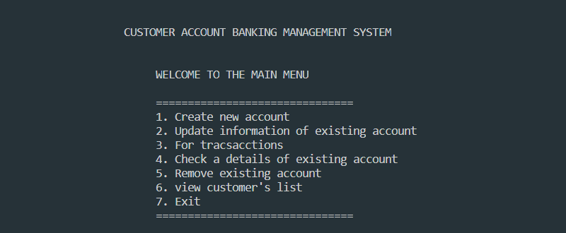
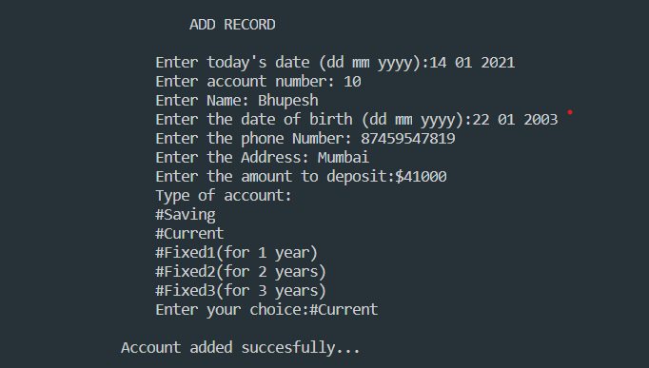
Micro Project Outputs
1. Menu
2. Create Account

Slide 20
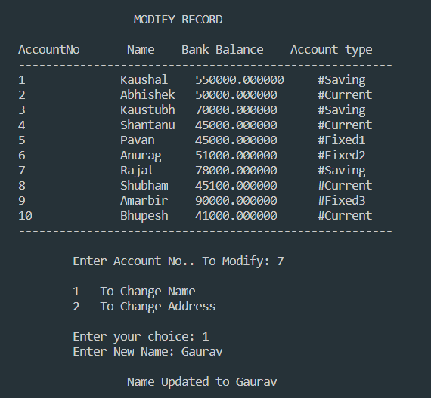
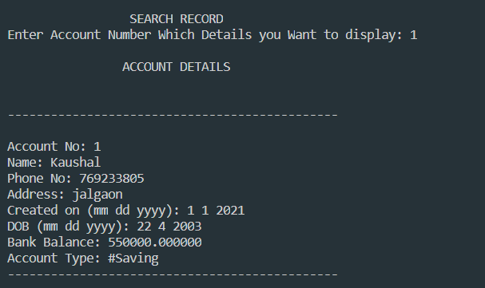
3. Modify Account Record
4. Check Details Of Existing Account

Slide 21
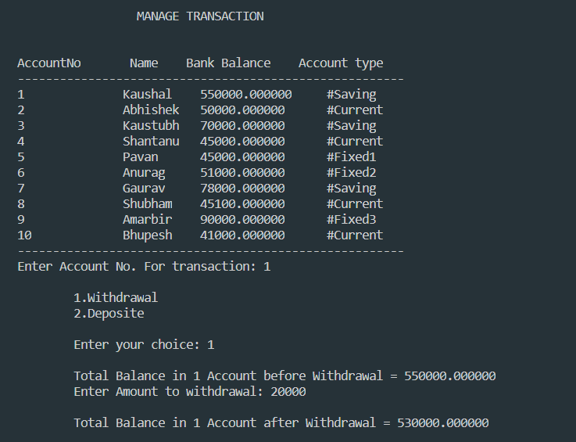
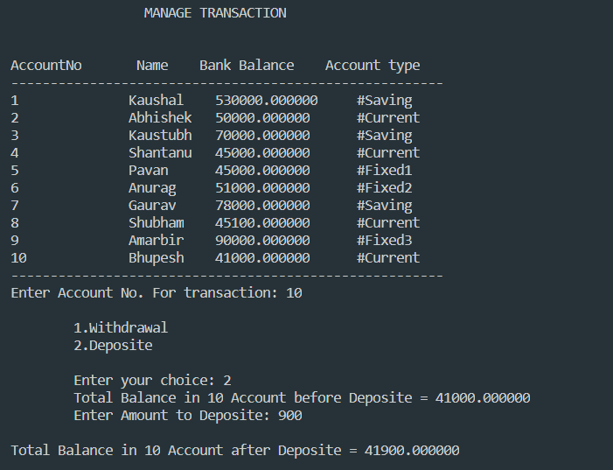
5. Manage Transaction

Slide 22
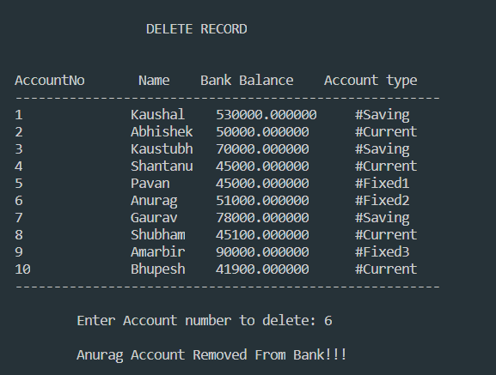
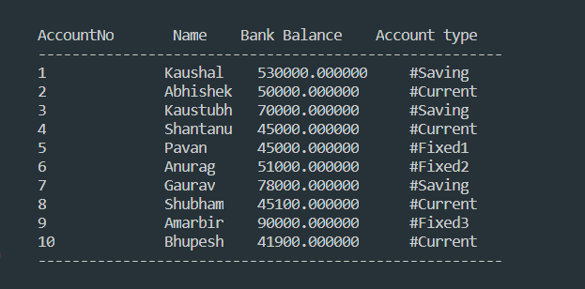
6. Delete Account From Bank
7. Display All Record

Slide 23
Conclusion
In this way we have learn about bank management system and its benefits. We have implement the program using linked list.
linked list is a linear data structure. We used different header files and function available in those header file to implement program.
we practice different operation on linked list such as insertion, deletion, traversing and searching using c language.
Future Scope:
Using File Handling
By Using Concept of Object Oriented Programming reliability and reusability increase.
3. We can use user level and administrator level authentication.

Slide 24
References
https://www.geeksforgeeks.org/time-h-header-file-in-c-with-examples/ - Use for adding time delay to the project
http://www.cplusplus.com/forum/windows/166491/ - use for formatted the output
https://www.sanfoundry.com/c-program-illustrate-user-authentication/ - use for authenticated code
Data Structure & Algorithum using c - use for dynamic memory allocation
https://www.upgrad.com/blog/data-structure-project-ideas-beginners/ - use for project idea

Slide 25
Course Outcomes Achieved
Implement basic operation on linked list.
Write an algorithm to Search the given node using linear Search.
Create relevant Structure to represent node using linked list

Slide 26


Slide 27


